Slide 1

Hungarian Language & Culture
Fall 2025

Slide 2
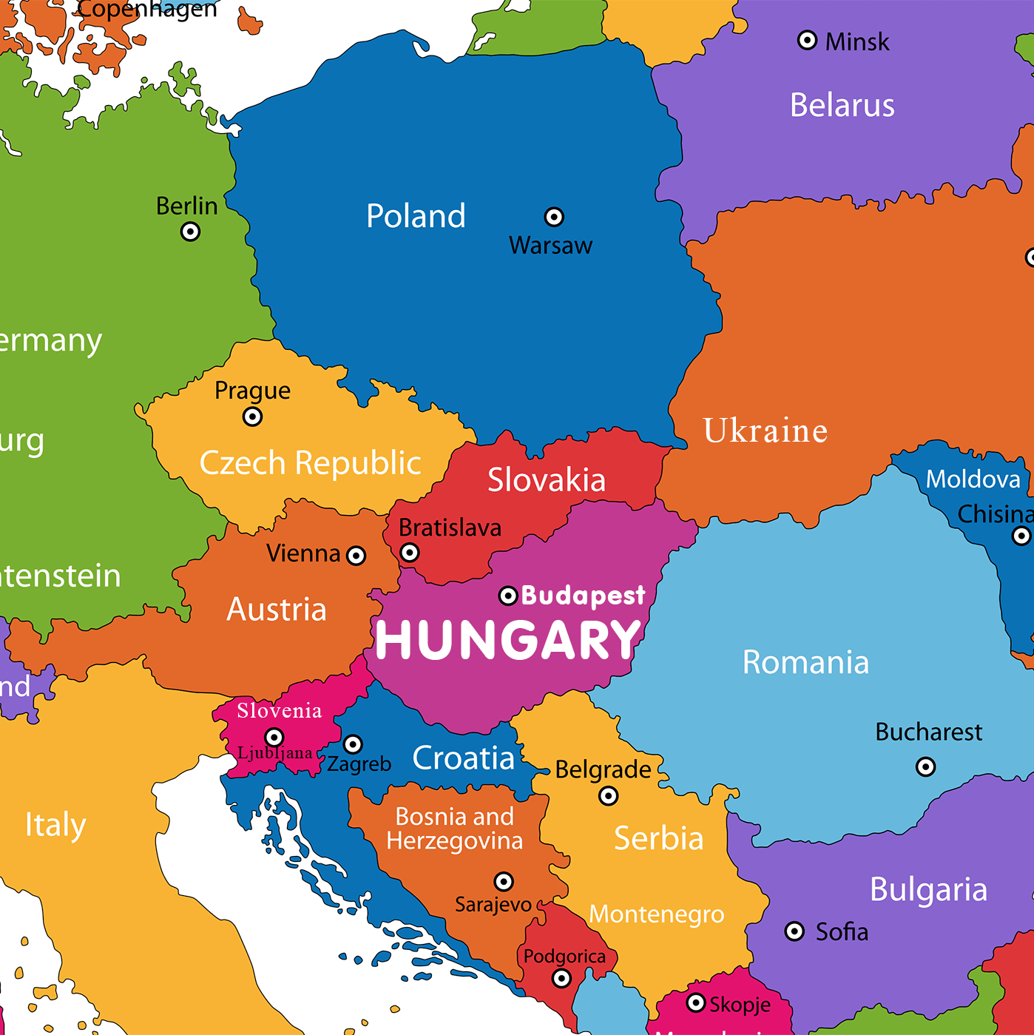
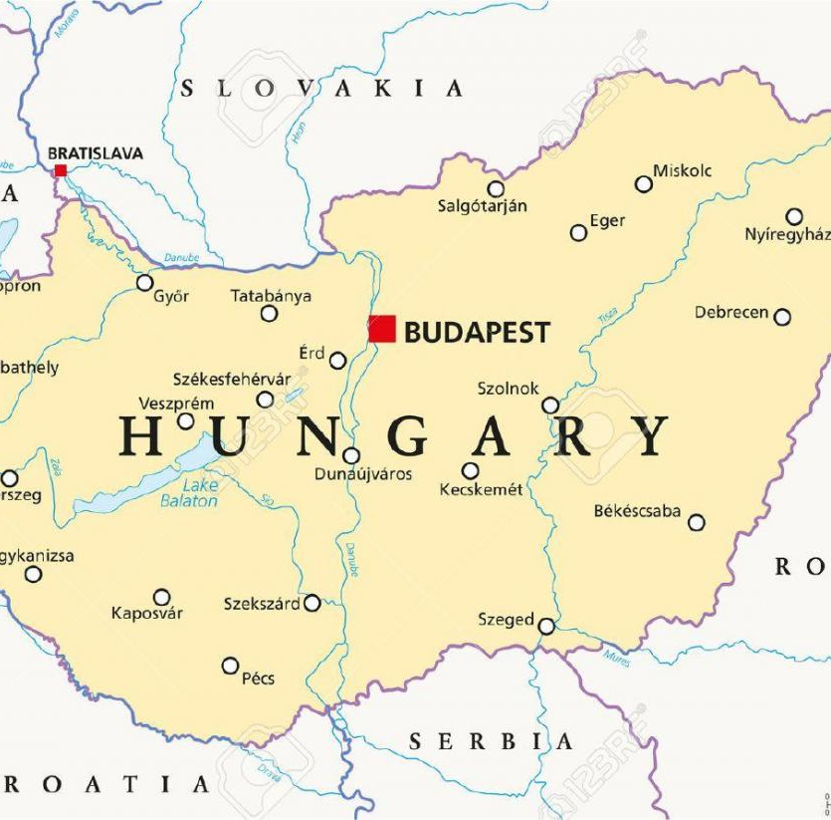

hungary

Slide 3


Hungarian language and culture course

Slide 4



learning a new language…
Attitude determines outcome
Language learning strategies – 4 skills

Slide 5

Teaching methods
Classroom teaching promotes…
  Flexible learning environment
  Student-centered learning
  Online & digital teaching materials
  Lots of practice in class
Project-based teaching & learning
  Collaborative learning
  creative mini projects

Slide 6


Textbook
Szita Szilvia, Pelcz Katalin: MagyarOK A1 KOmpakt, Magyar Nyelvkönyv. Pécs: Pécsi Tudományegyetem, 2022.
textbook & exercise book with online resources
covered in TWO TERMS
Available
  University Bookstore for purchase
  University Library for rent
  course page on szelearning

Slide 7

New course features
4 lessons per week (2×90 minutes) – taught by one instructor per group
Maximum 15–20 students per group
2 credits – counted beyond the mandatory 180/210 credits required for graduation
Mandatory: For international students with Stipendium Hungaricum, Christian youth, and Diaspora scholarships
Optional: For self-funded international students or those in dual-degree programs — they are not required to enroll in or complete the course
Assessment: on-going evaluation, 5-point grading system with oral and written final assignments at the end of each semester

Slide 8

assessment
Pre-requisite for advancing to next term: instructor’s signature & final grade
Criteria for obtaining the signature:
  Mandatory class attendance
  minimum 60% of accumulated results in classwork
Criterion for passing the course:
  60% or higher in classwork results

Slide 9

Evaluation & Grading system
Overall Grading Scheme Used in the Course
90% - 100% | 5 (excellent)
80% - 89% | 4 (good)
70% - 79% | 3 (average)
60% - 69% | 2 (satisfactory)
59% or lower | 1 (unsatisfactory)

Slide 10
Extra-curricular activities

Slide 11



Extra-curricular activities
Hungarian club
Hungarian Language mentoring club
Hungarian film club
Further details here: https://nykk.sze.hu/magyar-es-nemzetkozi-kulturak-osztaly

Slide 12
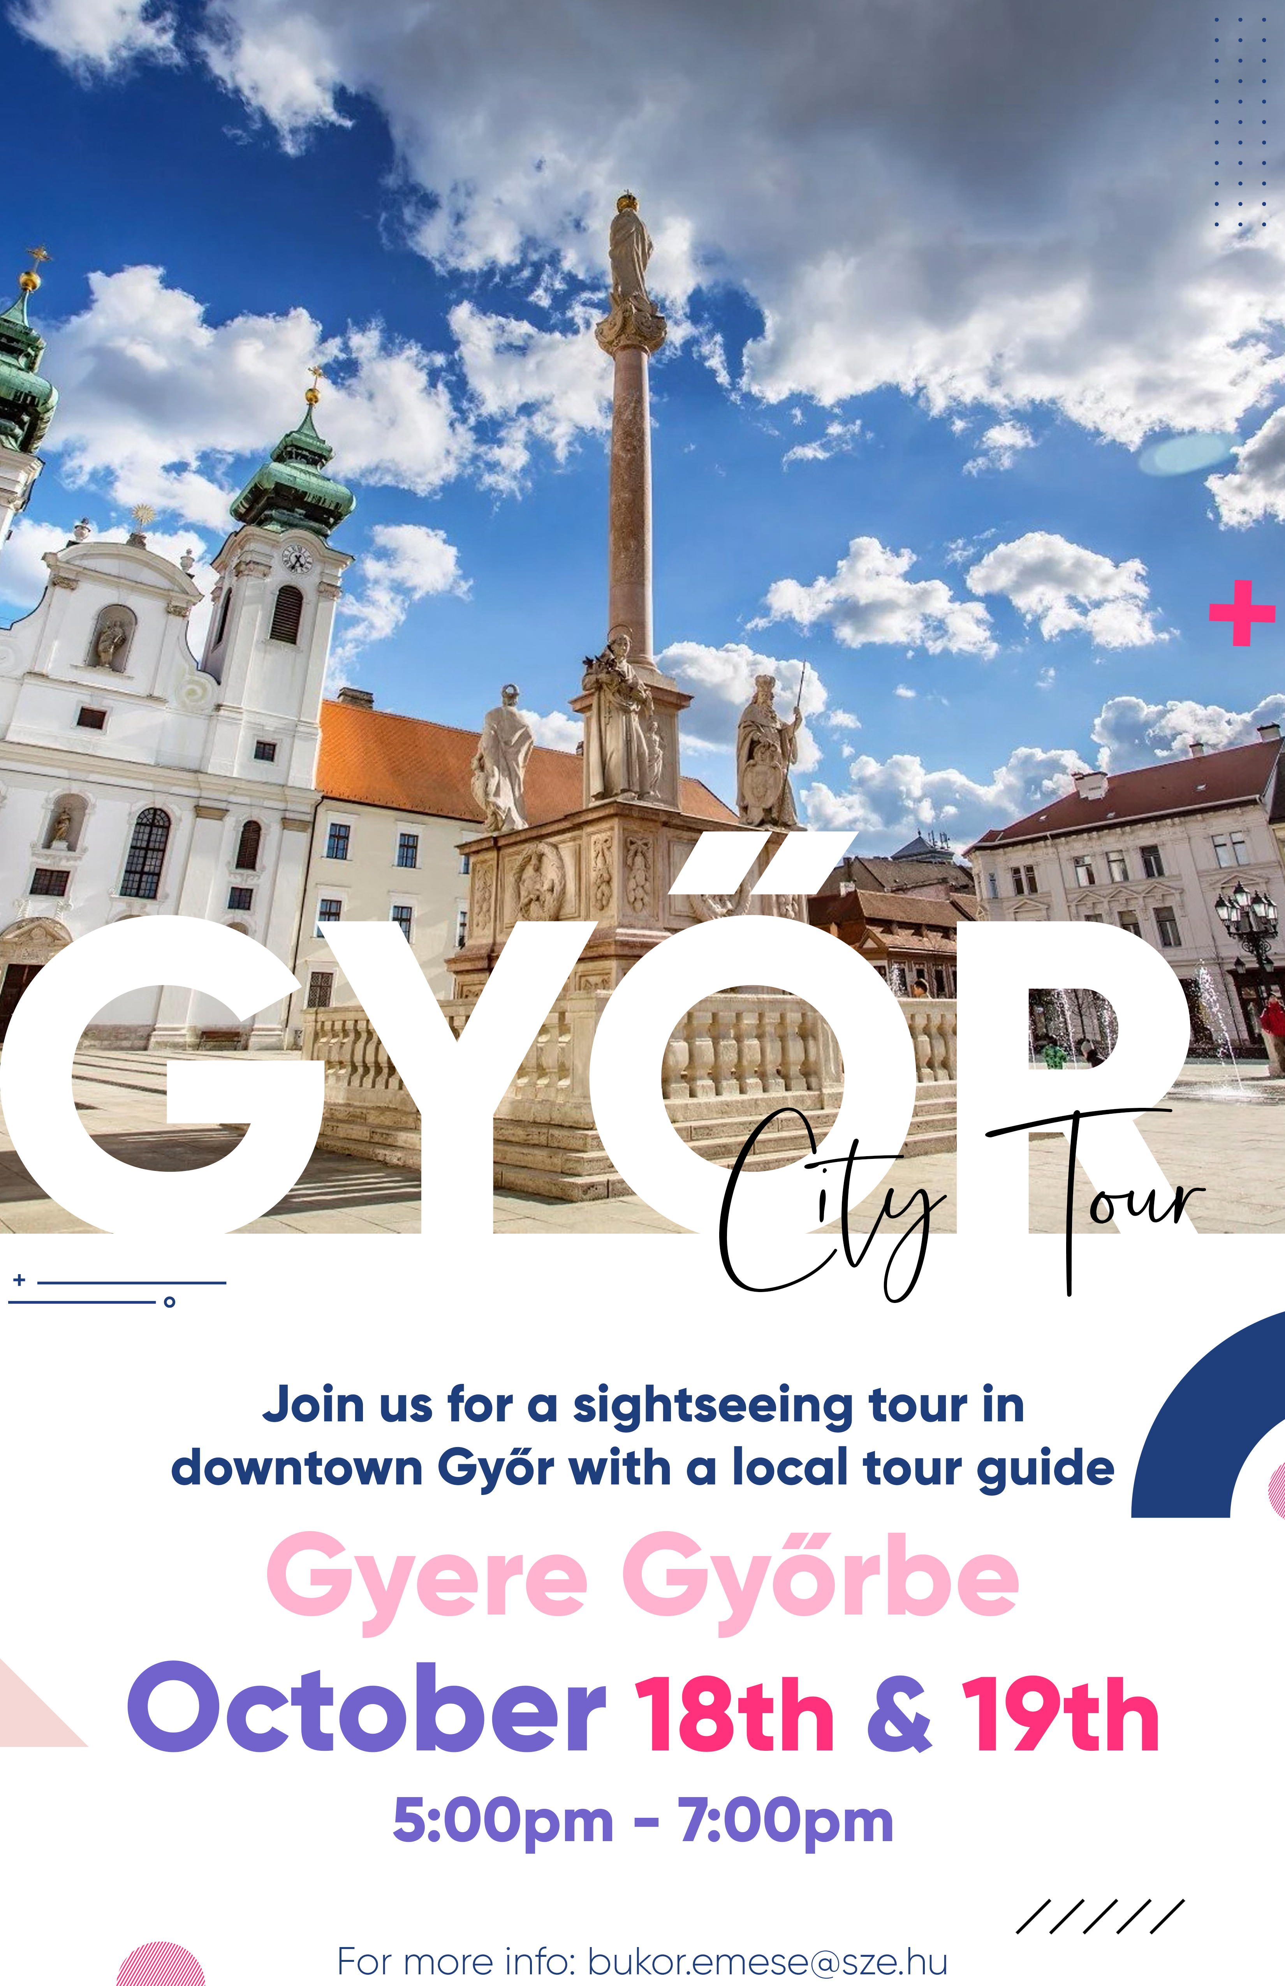
Cultural & social events
Hungarian club:
Fall term:
  Sightseeing tours in győr
  club events on Hungarian culture
Spring term:
  trips & hikes
Hungarian language Mentoring club:
  in-person club activities & fun language games

Slide 13
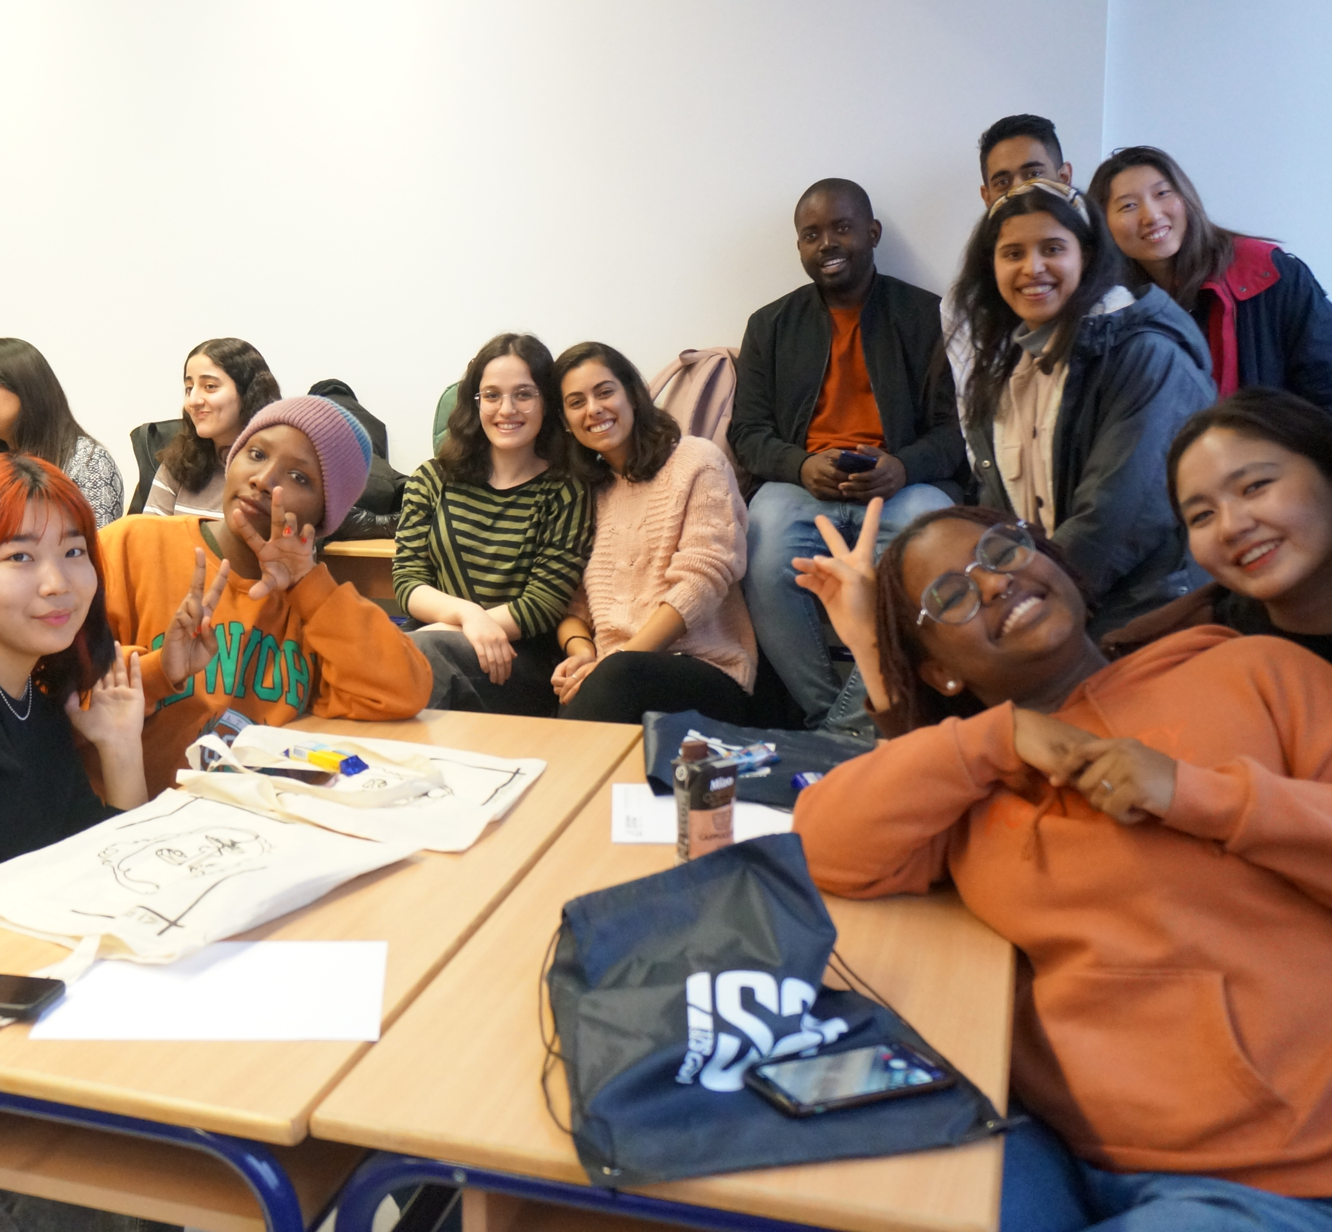
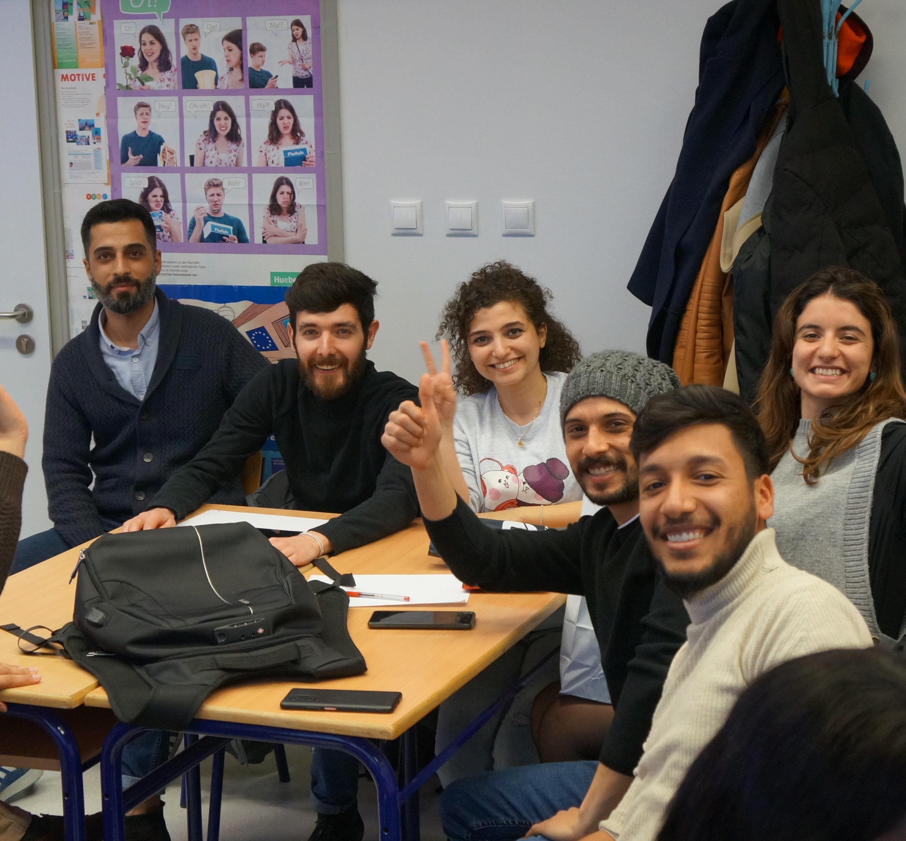
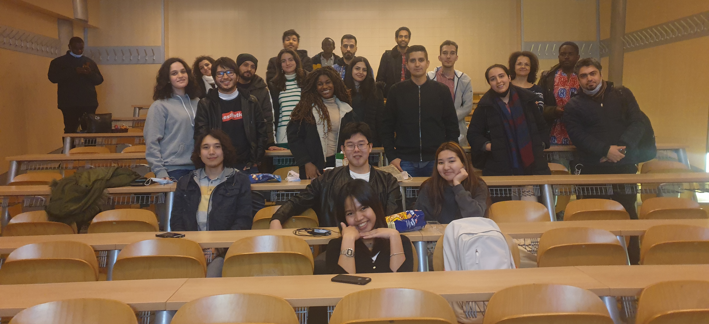
Cultural events
Optional Facebook group – Hungarian mentoring-sze
  closed group
  Approval required to join
  Content: Hungary & Hungarian culture, cultural events at university & in town
https://www.facebook.com/groups/hungarianmentoringsze

Slide 14




Hungarian film club
See previous film club events here: https://nykk.sze.hu/magyar-filmklub-1

Slide 15
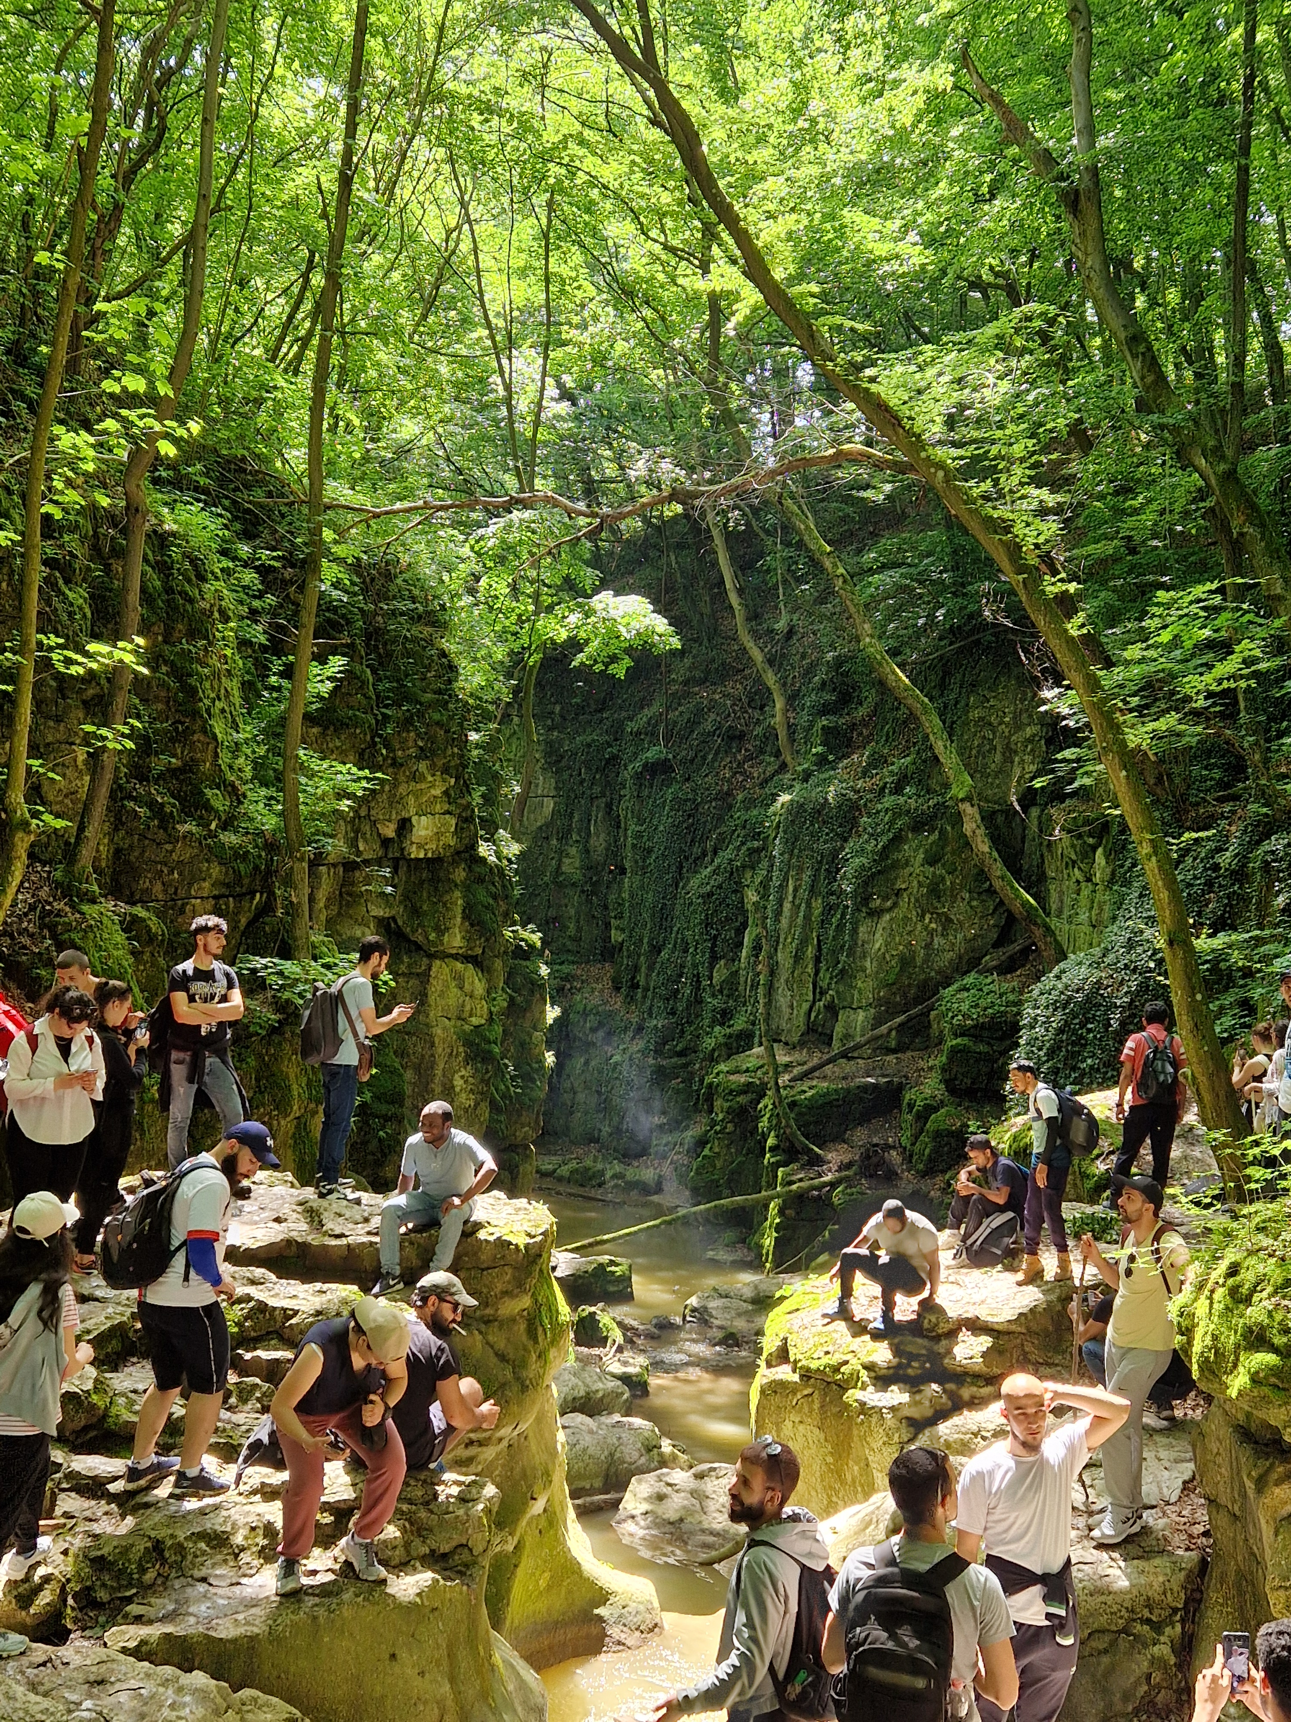
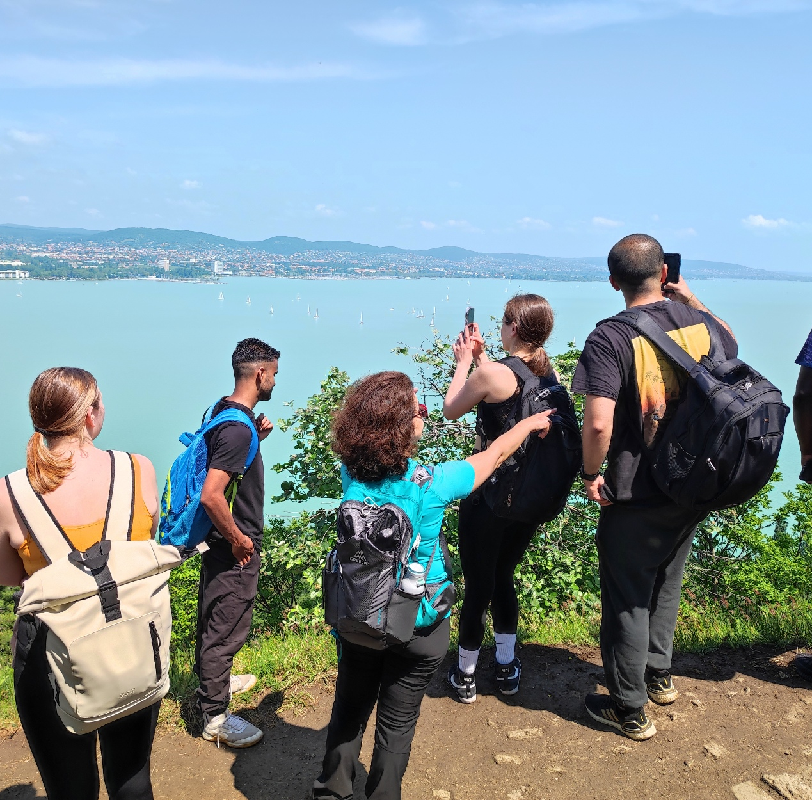
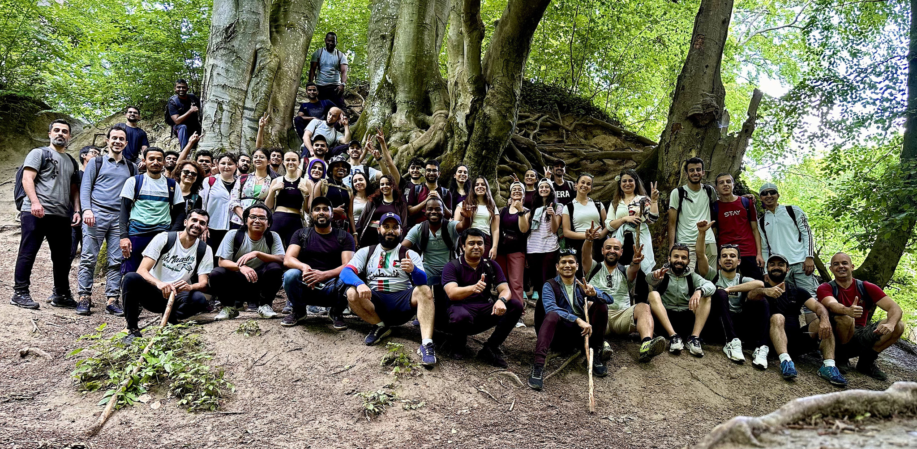
Hungarian club trips
See previous trips here: https://nykk.sze.hu/magyar-klub-1

Slide 16

Sok sikert!

